Slide 1
Rules of Inference

Slide 2
Outline
What is rule of inference
Rules of inference for Propositional Logic
Rules of inference for First-order Predicate Logic
Using Rules of Inference

Slide 3
命题逻辑的推理
数理逻辑的主要任务是提供一套推理规则。从给定的前提出发，推导出一个结论来。
前提是一些已知的命题公式
结论是从前提出发，应用推理规则推出的命题公式。
而这推理过程称为演绎或形式证明。

Slide 4
关于重言蕴含⇒
定义：
A、C是两个公式，如果A→C是重言式则称A重言蕴含C，或称A能逻辑地推出 C 记作A ⇒ C
说明：
→与⇒是有区别的，→是联结词，A→C仍然是公式，而⇒是公式关系符。
⇒ 描述了两个公式的关系，只能说A ⇒ C式成立或不成立。
公式A→C，当且仅当A真C假时才为假，因此A ⇒ C要成立的充要条件是对一切赋值如果使A为真，必须使C也为真。

Slide 5
重言蕴含⇒
定义：设A₁、A₂、…、A_{m}、C是命题公式，如果
（ A₁∧A₂ … ∧A_{m}）→C是重言式，则称C是前提集合{ A₁、A₂、…、A_{m} }的有效结论，或称由{A₁、A₂ 、…、A_{m} }逻辑地推论出C。
由⇒的定义，可以记作（ A₁∧A₂ … ∧A_{m}）⇒ C。

Slide 6
Rules of Inference
Many of the tautologies are rules of inference. They have the form
P₁ ∧ P₂∧.....∧P_{n} ⇒Q
where
P_{i} are called the hypotheses（前提）
and
Q is the conclusion（结论）.
Q logically follows from P₁ , P₂, …,P_{n}

Slide 7
Rules of Inference -推理规则
As a rule of inference they take the symbolic form:
P₁
P₂
.
.
P_{n}
∴Q
where ∴ means 'therefore' or 'it follows that.'

Slide 8
Note
To "prove the theorem" means to show that the implication is a tautology.
not trying to show that Q (the conclusion) is true, but only that Q will be true if all the P_{i} are true.
mathematical proofs often begin with the statement "suppose that P₁ , P₂, . . . , and P_{n} are true" and conclude with the statement "therefore, Q is true‘.
The proof does not show that Q is true, but simply shows that Q has to be true if the P_{i} are all true.

Slide 9
Rules of Inference
Arguments based on tautologies represent universally correct methods of reasoning.
Their validity depends only on the form of the statements involved and not on the truth values of the variables they contain. Such arguments are called rules of inference.

Slide 10
Rules of Inference
The various steps in a mathematical proof of a theorem must follow from the use of various rules of inference.
A mathematical proof of a theorem must begin with the hypotheses, proceed through various steps, each justified by some rule of inference, and arrive at the conclusion.

Slide 11
modus ponens(假言推理规则）
The tautology P ∧ (P→Q) → Q becomes
P
P→Q
∴Q
This means that whenever P is true and P→Q is true we can conclude logically that Q is true.

Slide 12
Famous rules of inference
P
∴P ∨ Q Addition（析取引入规则）
P ∧ Q
∴P Simplification（合取消去规则）
¬Q
P → Q
∴¬P Modus Tollens （拒取式）
P → Q
Q → R
∴P → R Hypothetical syllogism（假言三段论）

Slide 13
Famous rules of inference
P ∨Q
¬P
∴Q Disjunctive syllogism （析取三段论）
P
Q
∴P ∧ Q Conjunction （合取引入规则）
P ∨Q
¬ P ∨ R
∴Q ∨ R Resolution（消解规则）
(P→Q) ∧ (R→S)
P ∨ R
∴Q∨ S Constructive dilemma (二难推论)

Slide 14
Formal Proofs
To prove an argument is valid or the conclusion follows logically from the hypotheses:
Assume the hypotheses are true
Use the rules of inference and logical equivalences to determine that the conclusion is true.

Slide 15
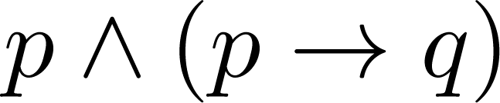
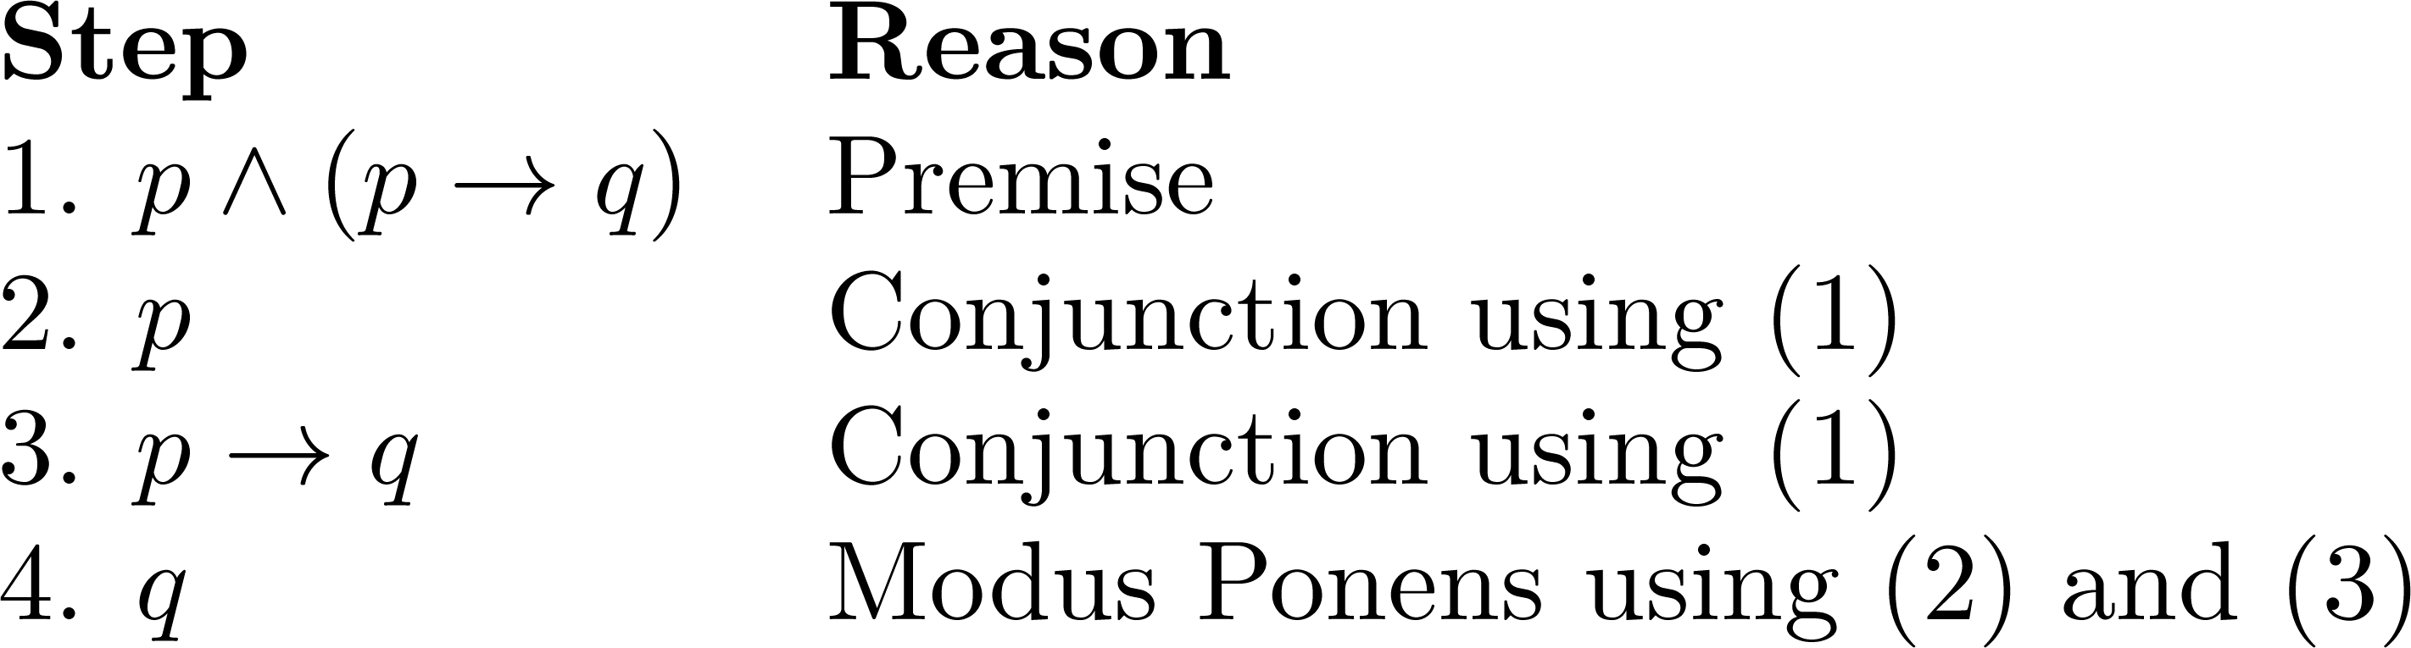
Valid Arguments
From the single proposition
Show that q is a conclusion.
Solution:

Slide 16
Example
Consider the following logical argument:
If horses fly or cows eat artichokes, then the mosquito is the national bird. If the mosquito is the national bird then peanut butter takes good on hot dogs. But peanut butter tastes terrible on hot dogs. Therefore, cows don't eat artichokes.
Assign propositional variables to the component propositions in the argument:
F Horses fly
A Cows eat artichokes
M The mosquito is the national bird
P Peanut butter tastes good on hot dogs

Slide 17
Example
Represent the formal argument using the variables
1.(F ∨ A) → M
2.M → P
3.¬P
∴¬A
Use the hypotheses 1., 2., and 3. and the above rules of inference and any logical equivalences to construct the proof.

Slide 18
Example-Formal Proofs
1.(F ∨ A) → M
2.M → P
3.¬P
∴¬A
Assertion Reasons
1.(F ∨ A) → M Hypothesis 1.
2.M → P Hypothesis 2.
3.(F ∨ A) → P steps 1 and 2 and hypothetical syll.
4.¬P Hypothesis 3.
5.¬(F ∨ A) steps 3 and 4 and modus tollens
6.¬F ∧¬A step 5 and DeMorgan
7.¬A ∧¬F step 6 and commutativity of 'and'
8.¬A step 7 and simplification
Q. E. D.
逻辑推理只关注推理过程的正确性
并不关注句子本身的含义是否正确

Slide 19
Example 6
Suppose we have the following premises:
“It is not sunny and it is cold.”
“We will swim only if it is sunny.” “If we do not swim, then we will canoe.” “If we canoe, then we will be home early.”
Given these premises, prove the theorem “We will be home early” using inference rules.

Slide 20
Example 6 cont.
Choose propositional variables:
p : “It is sunny.” q : “It is cold.”
r : “We will swim.” s : “We will canoe.”
t : “We will be home early.”
Translation into propositional logic:
Then, the premises can be written as: (1) ¬p ∧ q (2) r → p (3) ¬r → s (4) s → t
Conclusion t

Slide 21
Example cont.
premises: (1) ¬p ∧ q (2) r → p
(3) ¬r → s (4) s → t
Conclusion t
Step Reason 1. ¬p ∧ q Premise #1. 2. ¬p Simplification of 1. 3. r→p Premise #2. 4. ¬r Modus tollens on 2,3. 5. ¬r→s Premise #3. 6. s Modus ponens on 4,5. 7. s→t Premise #4. 8. t Modus ponens on 6,7.

Slide 22
Resolution
Example 9
Show that the hypotheses (p∧q)∨r and r→s imply the conclusion p∨s.
Step Reason 1. (p∧q)∨r Premise #1. 2. (p∨r) ∧(q∨r) Distributive of 1. 3. p∨r ∧ - of 2. 4. r→s Premise #2.
5. ¬r∨s Implication of 4.
6. p∨s Resolution on 3,5.

Slide 23
一阶逻辑推理定律(定义)
推出： A⇒B
读作：A推出B
含义：A为真时, B也为真
A⇒B 当且仅当 A→B是永真式
例如： ∀xF(x) ⇒ ∃xF(x)
F

Slide 24
一阶逻辑推理定律(来源)
命题逻辑推理定律的代换实例
基本等值式生成的推理定律
其他的一阶逻辑推理定律
∀xA(x)∨∀xB(x) ⇒ ∀x(A(x)∨B(x))
∃x(A(x)∧B(x)) ⇒ ∃xA(x)∧∃xB(x)
∀x(A(x)→B(x)) ⇒ ∀xA(x)→∀xB(x)
∀x(A(x)→B(x)) ⇒ ∃xA(x)→∃xB(x)

一阶逻辑量词相关的推理规则

Slide 25
一阶逻辑推理定律(举例)
命题逻辑推理定律的代换实例
例如: 假言推理规则:
(A→B )∧A⇒B
代入 A=F(a), B=G(a), 得到
(F(a)→G(a))∧F(a)⇒G(a)

Slide 26
一阶逻辑推理定律(举例、续)
基本等值式生成的推理定律
即由 A⇔B 可得 A⇒B 和 B⇒A
例如: 量词分配等值式:
∀x(A(x)∧B(x)) ⇔ ∀xA(x)∧∀xB(x)
可得
∀x(A(x)∧B(x)) ⇒ ∀xA(x)∧∀xB(x)
∀xA(x)∧∀xB(x) ⇒ ∀x(A(x)∧B(x))

Slide 27
推理定律与推理规则
推理定律A⇒B表示A→B是永真式
推理规则是在证明过程中使用的规则
每一条推理定律都可以作为推理规则
有些推理规则不是推理定律

Slide 28
一阶逻辑的常用推理规则
前提引入、结论引入、置换规则
假言推理、析取引入、合取消去、拒取式、合取引入、假言三段论、析取三段论、消解规则、构造性两难
一阶逻辑量词相关的推理规则
UI、UG、EI、EG

Slide 29
UI规则(universal instantiation)
表示为 ∀xA(x) ∀xA(x)
———— 或 ————
∴ A(y) ∴ A(c)
注意1: y是自由变项； c是个体常项
注意2: 被消去量词的辖域是整个公式
例如
(1) ∀x(F(x)→G(x)) 前提引入
(2) F(a)→G(a) (1)UI

Slide 30
UG规则(universal generalization)
表示为 A(y)
————
∴ ∀xA(x)
注意1: y是自由变项
注意2: 量词加在整个公式前面
例如 (1) F(y)→G(y) 前提引入 (2) ∀x(F(x)→G(x)) (1)UG

Slide 31
EI规则(existential instantiation)
表示为 ∃xA(x)
————
∴ A(c)
注意1: c是特定的满足A的个体常项
注意2: 被消去量词的辖域是整个公式
例如
(1) ∃x(F(x)∧G(x)) 前提引入
(2) F(a)∧G(a) (1)EI

Slide 32
EG规则(existential generalization)
表示为 A(c)
————
∴ ∃xA(x)
注意1: c是个体常项
注意2: 量词加在整个公式前面
例如
(1) F(c)∧G(c) 前提引入
(2) ∃x(F(x)∧G(x)) (1)EG

Slide 33
构造推理的证明(举例)
前提: ∀x(F(x)→G(x))，F(a)
结论: G(a)
证明: (1) F(a) 前提引入
(2) ∀x(F(x)→G(x)) 前提引入
(3) F(a)→G(a) (2)UI
(4) G(a) (1)(3)假言推理

Slide 34
构造推理的证明(举例、续)
前提: ∀x(F(x)→G(x))，∃xF(x)
结论: ∃xG(x)
证明: (1) ∃xF(x) 前提引入
(2) F(c) (1) EI
(3) ∀x(F(x)→G(x)) 前提引入
(4) F(c)→G(c) (3) UI
(5) G(c) (2)(4)假言推理
(6) ∃xG(x) (5) EG

Slide 35
构造推理的证明(举例、续)
“先EI，后UI”
证明: (1) ∀x(F(x)→G(x)) 前提引入
(2) F(c)→G(c) (2) UI
(3) ∃xF(x) 前提引入
(4) F(c) (3) EI
  
说明：这个证明是错的. (3)(4)应当在(1)(2)前，(4)中的c是特定的， (2)中的c是任意的

Slide 36
构造推理的证明(举例、续)
前提: ¬ ∃x(F(x)∧H(x)), ∀x(G(x)→H(x)),
结论: ∀x(G(x)→ ¬ F(x))
证明: (1) ¬ ∃x(F(x)∧H(x)) 前提引入
(2) ∀x(¬ F(x)∨ ¬ H(x)) (1)置换
(3) ∀x(H(x)→ ¬ F(x)) (2)置换
(4) H(y)→ ¬ F(y) (3) UI
(5) ∀x(G(x)→H(x)) 前提引入
(6) G(y)→H(y) (5) UI
(7) G(y)→ ¬ F(y) (4)(6)假言三段论
(8) ∀x(G(x)→ ¬ F(x)) (7) UG

Slide 37
Example
Every man has two legs. John Smith is a man. Therefore, John Smith has two legs.
Define the predicates:
M(x): x is a man
L(x): x has two legs
J: John Smith, a member of the universe

Slide 38
Example
The argument becomes
1.∀x[M(x) → L(x)]
2.M( J )
∴L( J)
The proof is
1.∀x[M(x) → L(x)] Hypothesis 1
2.M( J ) → L(J ) step 1 and UI
3.M( J ) Hypothesis 2
4.L( J) steps 2 and 3 and modus ponens
Q. E. D.

Slide 39
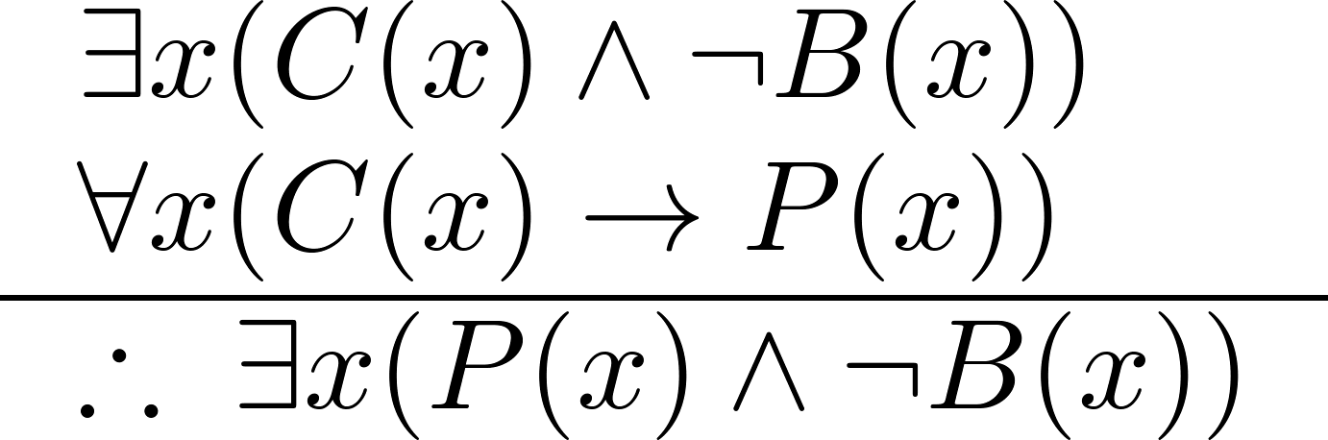
Using Rules of Inference
Example 2: Use the rules of inference to construct a valid argument showing that the conclusion
“Someone who passed the first exam has not read the book.”
follows from the premises
“A student in this class has not read the book.”
“Everyone in this class passed the first exam.”
C(x)：“x is in this class,”
B(x)： “ x has read the book,”
P(x)： “x passed the first exam.”

Slide 40
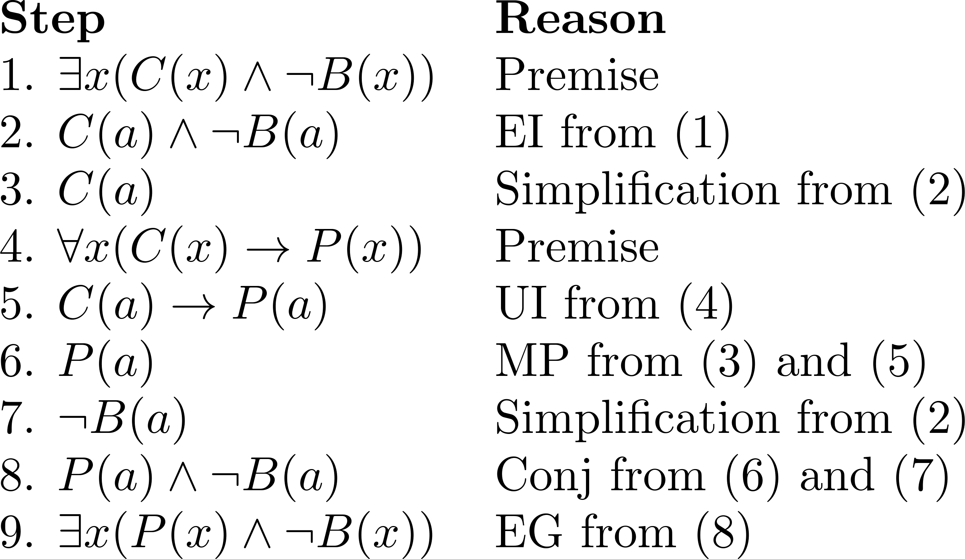
Using Rules of Inference
Valid Argument:

Slide 41
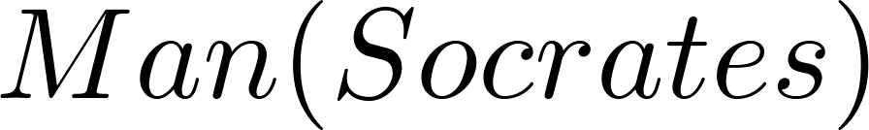
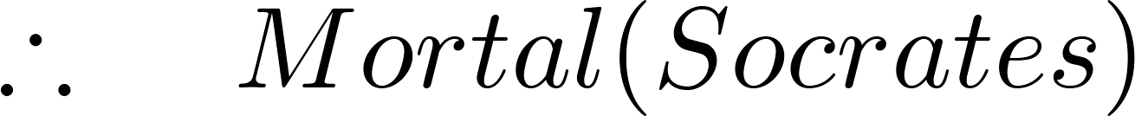
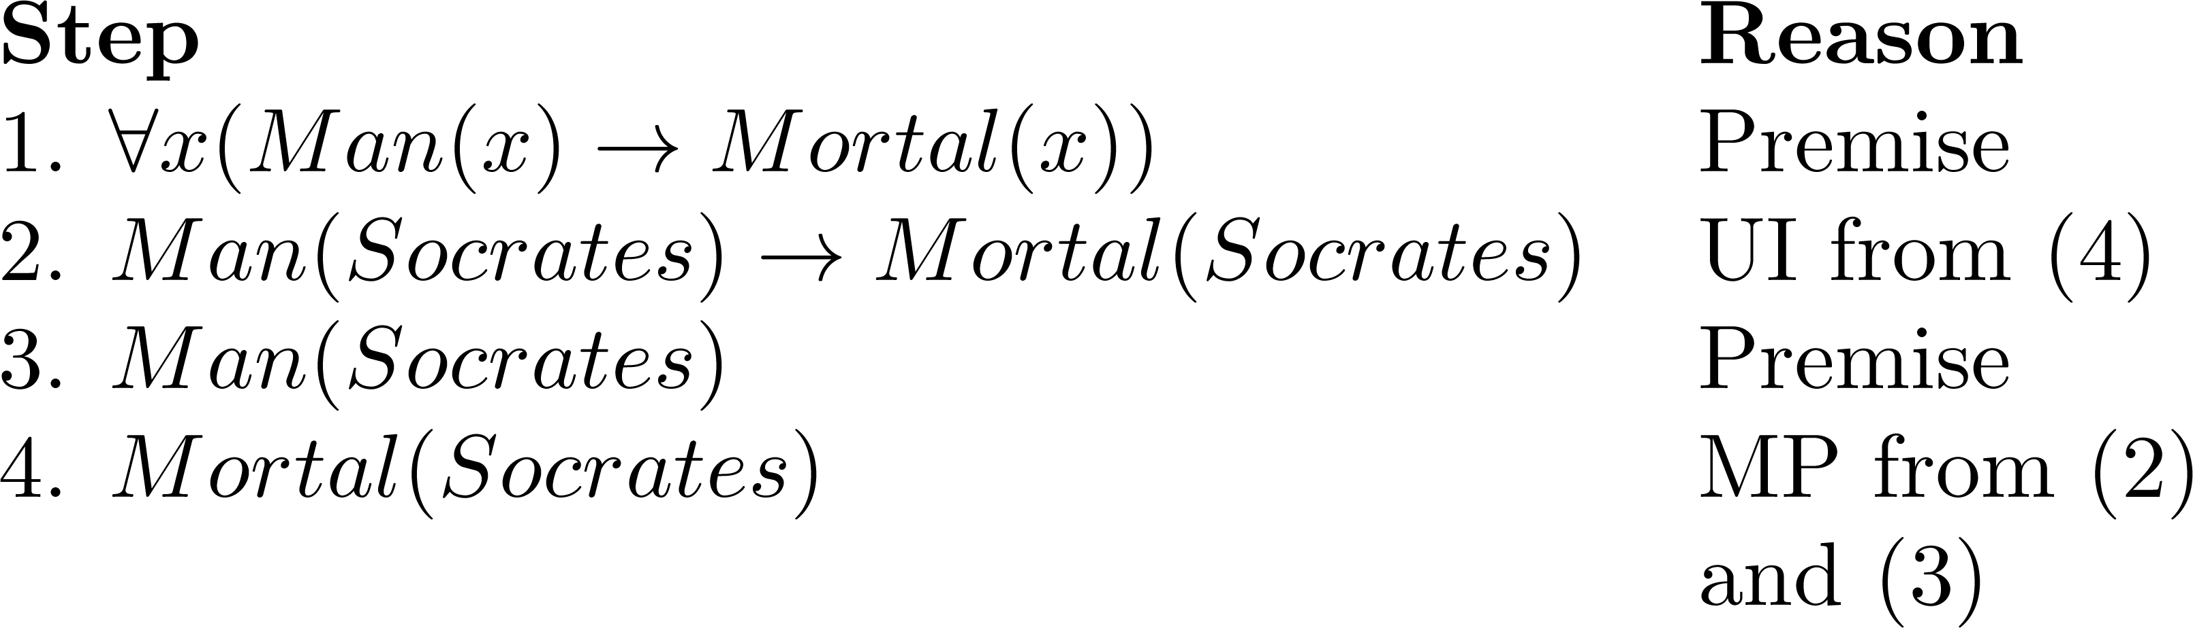
Returning to the Socrates Example
Valid Argument

Slide 42
Homework
§1.6
4, 6, 12, 16, 20, 24
推理的形式化证明方法：
设计命题或谓词
给出前提和结论的形式化表示
推理过程要完整
给出规范的三列形式

